Slide 1
Mind melders -Bangalore

Slide 2
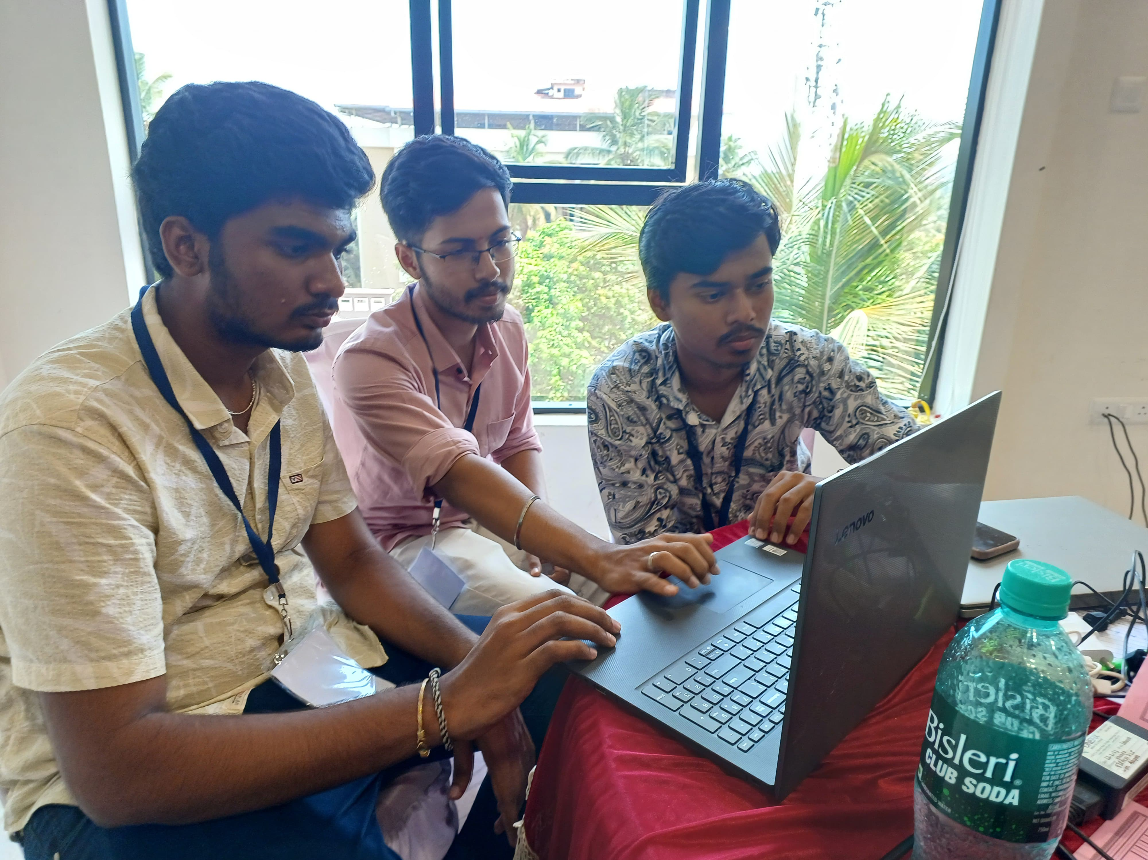
About Us
Mind melders
We are the Mind Melders, a dynamic team of four undergraduate engineering students from BGS College of Engineering Technology in Bangalore. United by our passion for innovation and technology, we are dedicated to pushing the boundaries of our field and making a meaningful impact through our collaborative efforts and diverse skill sets.

Slide 3




Problem
Mind melders
Customer service:- Revolutionize customer interaction and boost satisfaction
Personalized Content:-Deliver tailored financial content for each user
Risk Management :- Identifying, assessing, and mitigating financial risk effectively
Operational Efficiency :-Enhancing bank operations through process automation and better resource allocation

Slide 4





Solution
Mind melders
Close the gap
Target audience
Time savings
Easy to use
Our product makes consumer lives easier, Aswell as focus on grasping the customers by various ai technologies used .
Customers and
Bank Employees
Reduce expenses for replacement products
Simple design that gives customers the targeted information they need​

Slide 5
About product
Mind melders
Introducing our state-of-the-art customer service chatbot, Aegis:
A revolutionary solution designed to elevate your banking experience with unmatched accuracy and reliability. Aegis boasts an impressive accuracy rate exceeding 95%, ensuring swift and precise resolution of your queries. This commitment to accuracy enhances overall satisfaction by providing timely and accurate information.
In addition to exceptional customer service,
Aegis offers advanced features such as secure challan generation and automatic email generation along with various other features. Secure challan generation integrates seamlessly with Bank of Baroda's systems, allowing you to effortlessly create and manage challans securely and efficiently. Meanwhile, automatic email generation simplifies communication by automatically sending important updates directly from the chatbox to your email inbox and to the bank, ensuring you stay informed at all times and thus saving time as Aegis provides the templates for all the specified problems.
Experience the future of customer service with Aegis, where precision meets convenience to deliver a seamless banking experience tailored to your needs. Discover how Aegis can transform your interactions with Bank of Baroda, setting new standards in customer service excellence and technological innovation.
Symbolizing protection and security

Slide 6
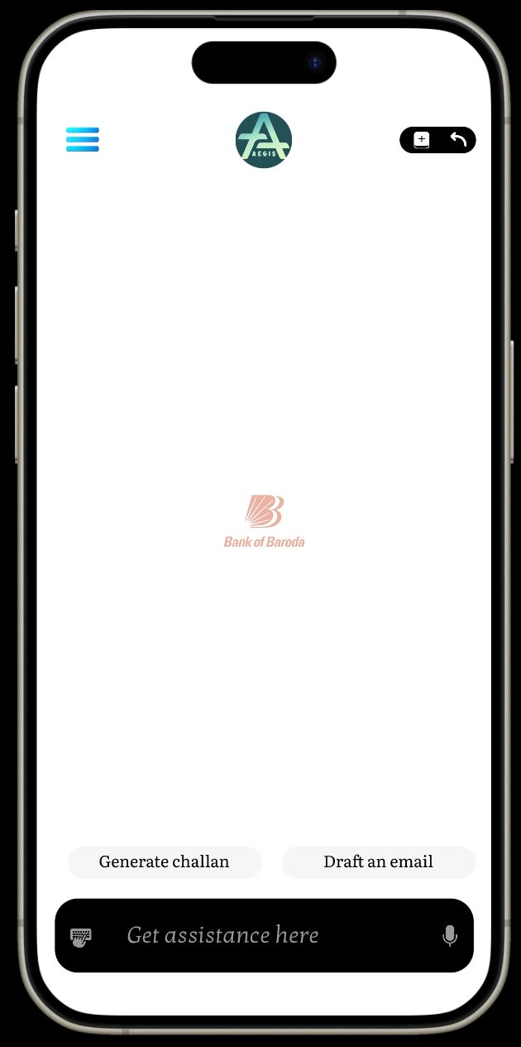
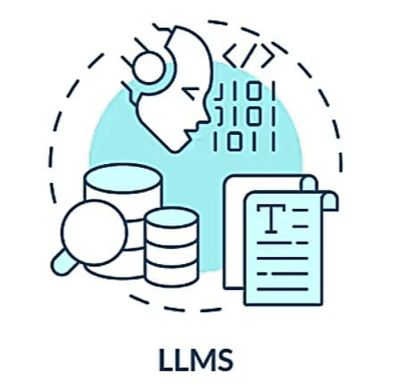


About product
Mind melders
Get assistance here
LLM
llm
DMS
RL
RL’S

Slide 7
Introducing Our Next-generation chatbot for bank of Baroda
Mind melders
Revolutionizing Customer Service with Cutting-Edge Technology
Leveraging Pre-Trained Large Language Models (LLMs): Our chatbot will be built on the robust foundations of pre-trained LLMs like Jurassic-1 Jumbo (AI21 Labs) or GPT 4 model. These state-of-the-art models are trained on vast amounts of text data, enabling them to handle a wide range of conversational tasks with remarkable accuracy and efficiency.
Tailored for Bank of Baroda: Domain Adaptation To ensure our chatbot understands and addresses the specific needs of Bank of Baroda customers, we fine-tune it using bank-specific data. This includes customer service transcripts, FAQs, product descriptions, and regulatory documents. This fine-tuning process helps the chatbot grasp banking terminology and comprehend the bank’s unique policies and procedures. Leveraging advanced LLM capabilities and a robust Dialog Management System (DMS), we enhance user experience with efficient, secure, and compliant banking services.

Slide 8
Introducing Our Next-generation chatbot for bank of Baroda
Mind melders
Revolutionizing Customer Service with Cutting-Edge Technology
Continuous Improvement with Reinforcement Learning (RL): We implement Reinforcement Learning to continually enhance our chatbot’s performance. By learning from user interactions and feedback, the RL system enables the chatbot to adapt and refine its responses over time, ensuring it remains accurate and effective.
Human-in-the-Loop (HITL) for Complex Queries: To guarantee a comprehensive support system, we incorporate a Human-in-the-Loop mechanism. This allows human agents to step in when the chatbot encounters complex issues that require human judgment. This hybrid approach ensures that all customer inquiries, no matter how intricate, are resolved satisfactorily.

Slide 9
Why choose AEGIS !!!
Mind melders
Key Features
High Precision Responses: Leveraging advanced AI algorithms, our chatbot consistently delivers accurate answers to your questions, minimizing the chances of errors.
24/7 Availability: Our chatbot is available round-the-clock, providing immediate assistance whenever you need it, without any waiting time.
User-Friendly Interface: Designed with the user in mind, our chatbot is intuitive and easy to navigate, ensuring a seamless interaction every time.
Continuous Learning: Our chatbot constantly learns from interactions, continually improving its accuracy and understanding to better serve you.

Slide 10
SECURE CHALLAN GENERATION
Mind melders
Our project integrates a seamless system for generating challans through the Bank of Baroda chatbot, prioritizing both security and efficiency. Users securely provide necessary information via the chatbot to create unique challan IDs within the bank's system. Authentication is robust, utilizing OAuth or OpenID Connect to ensure sensitive user credentials are not stored within the chatbot.
Users enjoy convenient options such as downloading challans as PDFs or unique IDs for printing at bank kiosks. The chatbot guides users through a secure login process and facilitates input of deposit amounts, seamlessly interacting with the bank's systems to initiate and finalize challan creation.
To enhance operational efficiency, each type of challan is managed through separate counters at bank branches. Once a unique challan ID is generated, it is securely stored by the bank along with the date of issuance. This streamlined approach enables customers to save time by presenting the ID to Bank of Baroda staff, who can instantly retrieve all details entered by the customer on the previous day.

Slide 11
SECURE CHALLAN GENERATION
Mind melders
Our solution places a strong emphasis on user security, ensuring all communications are encrypted and compliant with regulatory standards like PCI DSS. Leveraging advanced LLM capabilities and a robust Dialog Management System (DMS), we enhance user experience with efficient, secure, and compliant banking services.
This integration exemplifies our commitment to leveraging technology for streamlined processes, enhancing customer convenience, and ensuring smooth operations within Bank of Baroda's banking system. By storing challan IDs and associated details securely, we facilitate a seamless experience that minimizes customer effort and optimizes service delivery.

Slide 12
Enhancing Customer Experience with Automatic Email Generation
Mind melders
We are excited to introduce a transformative feature: Automatic Email Generation directly from our developed chatbot (Aegis). This innovative solution revolutionizes how we communicate with our customers, offering seamless integration and enhanced convenience. Through our chatbot interface, customers can effortlessly initiate the generation of emails for the particular query, notifications and documentations such as account statements, transaction confirmations, and service requests. Our system collects necessary details like recipient email addresses and message content, Automating the process securely and efficiently. Leveraging advanced technologies, including robust encryption and secure API integrations, ensures the protection of sensitive information throughout the transmission process. This initiative not only streamlines customer interactions but also strengthens security measures, aligning with regulatory standards like and PCI DSS. We are committed to delivering personalized and timely communications, thereby enriching the overall banking experience for our valued customers.

Slide 13
Personalized content generation
Personalized Recommendations
with AI
Transaction Insights and AI-powered Alerts
And many more
to come in future

Slide 14
Personalized content generation
Mind melders
Personalized Recommendations with AI
Leverage user transaction data to understand spending habits and financial interests. Integrate with Bank of Baroda's internal data (with consent) to gather demographics and investment preferences. Developing an AI system to analyze this data and identify areas of interest, such as travel budgeting tips for frequent travelers or investment opportunities aligned with inferred risk tolerance. It will display personalized articles, investment insights, and financial tips through the Bank of Baroda app. Using techniques like collaborative filtering or content-based recommendations with libraries like scikit-learn or Surprise to enhance user engagement and financial decision-making.

Slide 15
Personalized content generation
Mind melders
Transaction Insights and AI-powered Alerts:-
Utilize transaction data from the Bank of Baroda app to calculate key metrics such as total debits, credits, and net balance. Implementing AI algorithms to analyze and identify spending trends and deviations from historical data. Generating AI-powered graphs and charts to visually represent spending patterns, key categories, and fluctuations. We are developing an AI system to detect potential spending concerns and trigger personalized alerts for issues like increased spending in specific categories or exceeding budgets. We are going to Use TensorFlow/PyTorch for analysis and Matplotlib/Plotly for visualization, enhancing financial awareness and control through timely insights and alerts.

Slide 16



Mind melders ai Model
Mind melders
Research​
Abstract​
Design​
We based our research on how customer would be satisfied
We believe people need more products specifically dedicated to this niche market​
Minimalist and easy to use ​

Slide 17
Our competition graphic
precision
Mind melders
aegis
chatbot
Non availability
24/7 availability
colleagues
friends
google
Inconvenient​
Not precise

Slide 18
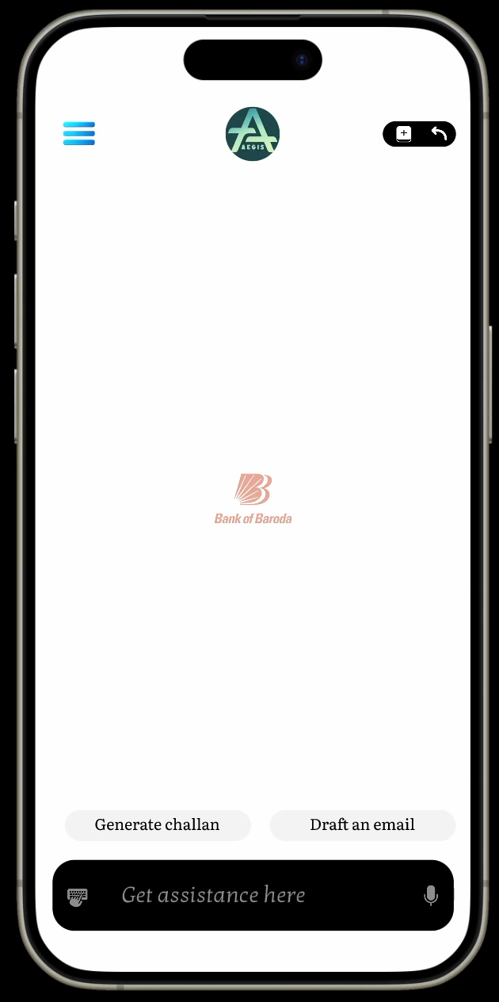
Summary and our product demo
Mind melders
Introducing *Aegis*, an innovative chatbot for the Bank of Baroda, designed to deliver personalized content, ensure secure challan generation, streamline communication with automatic email generation, provide real-time transaction insights and AI-powered alerts, and offer customized financial recommendations based on user data.
Demo video link :
https://drive.google.com/file/d/1C-uf_ZrznfP0MuauHKmfFkhZKmqpQkBP/view?usp=sharing
Note : Please play the video.

Slide 19
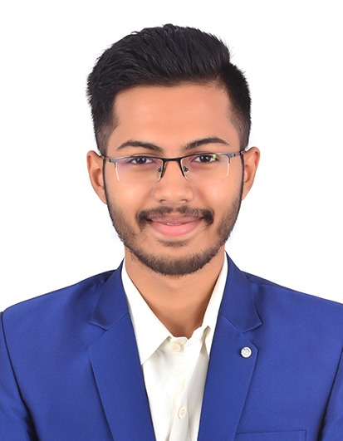
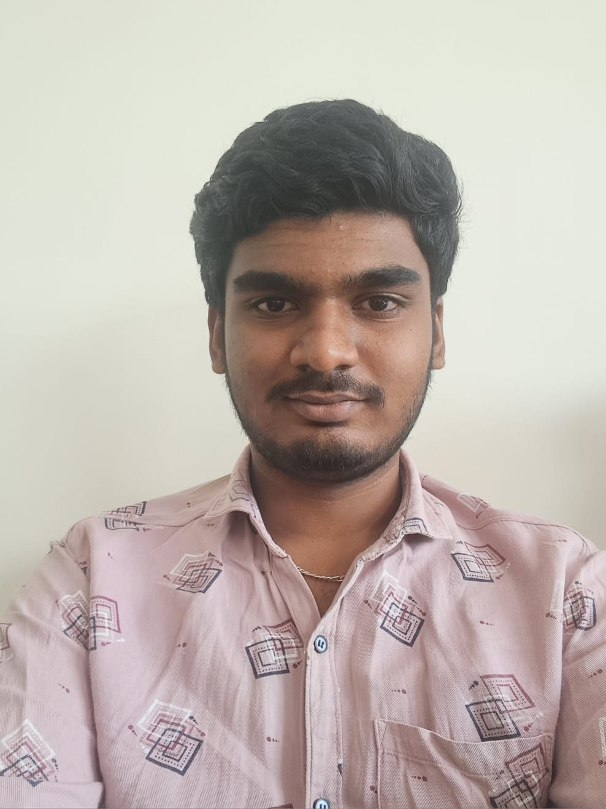
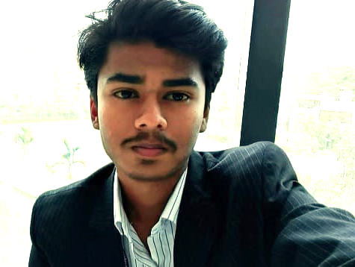
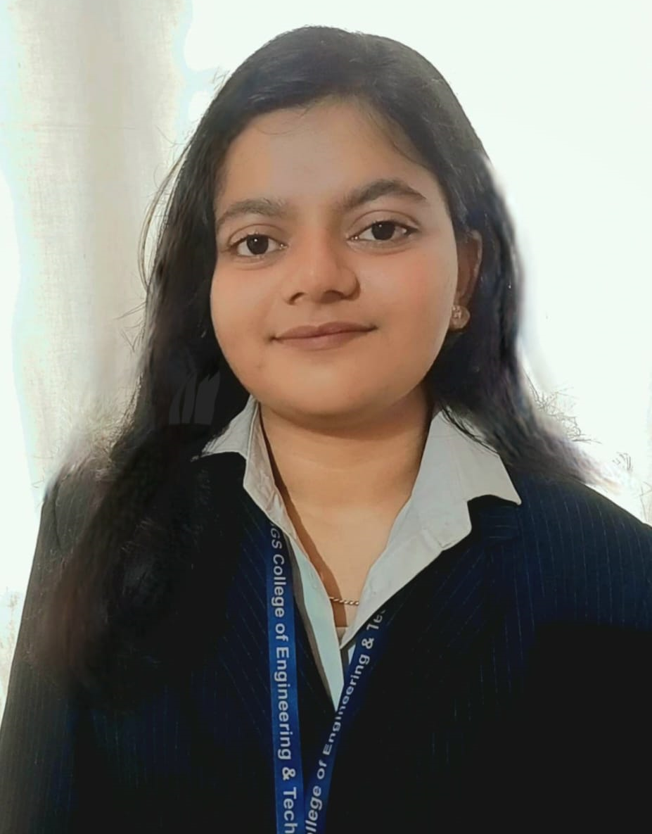
Our team
RISHIKESH T.R
YASHAS S
HARSHA C
ROSHINI D

Slide 20
Thank you
Mind melders
- Mind Melders

